Slide 1


Student Exception Announcement Training guide for Michigan schools
Notes:
Welcome to the Michigan Pandemic EBT Student Exception Announcement Training Guide for Michigan Schools! I’m Melissa. Today’s training will explain some additional steps that school buildings may be required to take based on their reported attendance type.

Slide 2
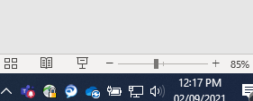

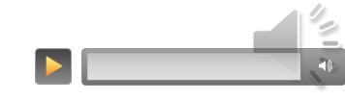

Viewing this Presentation with Audio
Slide Show Button:
This presentation is narrated. It is recommended to view this PowerPoint in presentation mode by clicking the “Slide Show” button in the lower right portion of this window, or by pressing the F5 key on your keyboard.
In presentation mode the audio narration will play automatically as you progress through the slides. The notes of each slide include a transcript of the narration. To replay the audio, hover your mouse over the speaker icon in the upper right and click the play button.
MI P-EBT 2.0 Reconsideration Training Guide 2020/2021 School Year

Slide 3
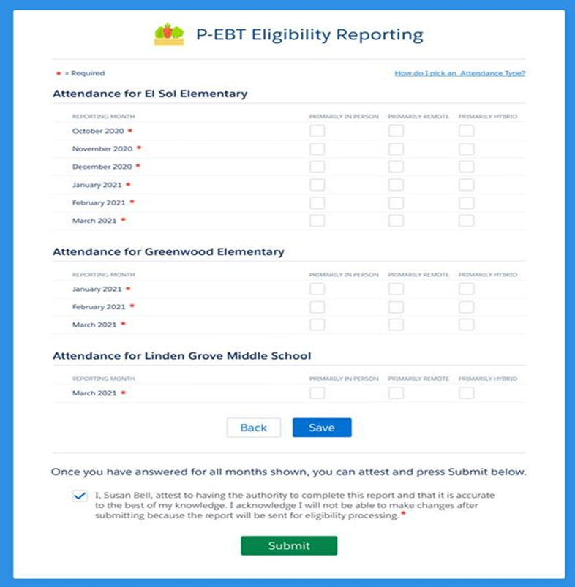
The School Survey was Completed, What’s Next?
For any month(s) a school building was reported as:
Primarily Remote – parent or guardian will be sent a notice regarding full benefit amount
Primarily Hybrid – parent or guardian will be sent a notice regarding reduced benefit amount
These months are all set!
MI P-EBT 2.0 Reconsideration Training Guide 2020/2021 School Year
Notes:
When your district submits the survey to report monthly attendance types for each building, this determines the benefit level and subsequently, the notice sent to parents or guardians of that building’s students. Primarily remote buildings will have notices issued regarding the full benefit amount. Primarily hybrid buildings will have notices issued regarding a reduced benefit amount. Any months that have been reported primarily remote or hybrid are all set and do not require additional action from the school.

Slide 4
The School Survey was completed, What’s Next?
For any month(s) a school building was reported as:
Primarily in-person –
  No benefits are issued
  No notice is sent to the parent
  Additional steps are needed
MI P-EBT 2.0 Reconsideration Training Guide 2020/2021 School Year
Notes:
For any months school buildings reported primarily in-person learning, benefits are not issued and no notice is sent to the parents/guardians. In these instances, there are additional steps the buildings will need to take.

Slide 5
Additional Steps
When a school building reported any month as primarily in-person:
MDHHS sends student exception announcement to the primary and secondary contacts
School district contacts will forward to appropriate school building
School building will be responsible for informing parents/guardians
  Post once
  Use at least two methods
MI P-EBT 2.0 Reconsideration Training Guide 2020/2021 School Year
Notes:
When primarily in-person learning is reported, MDHHS will first send an official notification, called a student exception announcement, to the district’s primary and secondary contacts. The contacts will forward the notification to the appropriate building(s), and each building will then be responsible for informing the parents or guardians of their building’s students. The notification must be posted once using at least two different methods, some of which are suggested on the next slide.

Slide 6


Suggested Notification Methods
Website | Post the entire message on the building homepage
Facebook | Share on your Facebook page
Twitter | Post on your Twitter page
Building Newsletters | Send information via your E-newsletter
Parent Notification System | Send an e-mail to all building parents or robocall
Printed postcard/flyer | Distribute to parents
Building Posting | Post on entrance doors
MI P-EBT 2.0 Reconsideration Training Guide 2020/2021 School Year
Notes:
Any two may be used to ensure parents/guardians are properly notified.

Slide 7
P-EBT Student Exception Announcement Activities
For months that a school reported primarily in-person, a parent/guardian has the option to request an individual review of their student’s circumstances. This process is called a reconsideration.
Example - Building began the 2020/2021 school year on Sept 8 with fully in-person learning. With news of COVID 19 cases increasing, one student opted to learn fully remote beginning Sept 16:
Building reports primarily in-person modality for September
MDHHS does not issue PEBT benefits
School district forwards announcement to identified school buildings
MDHHS sends student exception announcement to districts who reported primarily in-person months
School buildings will post parent notification in two ways
MI P-EBT 2.0 Reconsideration Training Guide 2020/2021 School Year
Notes:
COVID -19 has impacted nearly every school in our state. It’s understood there may be students in a primarily in-person building who learned under a different modality. Parents or guardians of these students will have the option to request an individual review of their student’s circumstances. This process is called a reconsideration. Here is an example. A building began the 2020/2021 school year on September 8th with fully in-person learning, but due to COVID cases increasing, one student opted to learn remotely beginning September 16^{th.} The school building will have reported primarily in-person modality for September, which means MDHHS does not automatically issue P-EBT benefits to this building’s students. The district contacts will receive notice from MDHHS instructing them to forward the information to the identified buildings. These buildings then post the announcement for their parents/guardians using two methods.

Slide 8
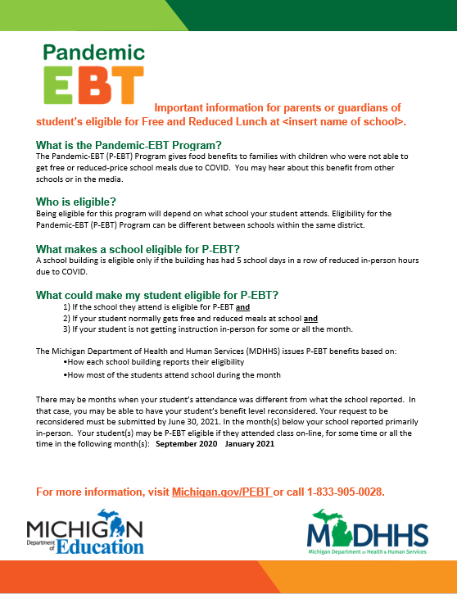
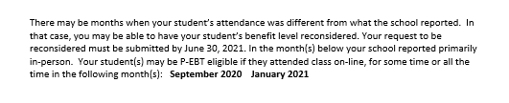
Sample Student Exception Announcement
Note: Notice is only sent to parent/guardian once for each issuance period. Specific months the student can request reconsideration will be at the bottom of the notice.
MI P-EBT 2.0 Reconsideration Training Guide 2020/2021 School Year
Notes:
This is what the student exception announcement from MDHHS will look like. The specific school building will be listed, with the months that were reported as primarily in-person shown at the bottom. These notices are only sent once per issuance period, and the months listed here are the ones that reconsideration may be requested for.

Slide 9
Guiding parents/guardians
When should a parent or guardian request reconsideration?
If they have a free/reduced lunch student who attended class partially or fully virtual in a month shown on their notice
What information will a parent or guardian need from the school?
A parent or guardian will need to provide proof that shows how their student received instruction for the month(s) on the notice. We call this a proof document. It will need to contain the following information:
Student’s name
The month(s) for which the parent is requesting a reconsideration
A statement about how the student received instruction for that month
Name of the school employee filling out the document
The school employee’s title, e-mail, and telephone number
  Can be completed by teacher, aide, secretary, counselor
Where can a parent or guardian find the form for a reconsideration?
The reconsideration form is at www.michigan.gov/pebt
MI P-EBT 2.0 Reconsideration Training Guide 2020/2021 School Year
Notes:
You may receive some of these questions from your building’s parents/guardians.

Slide 10
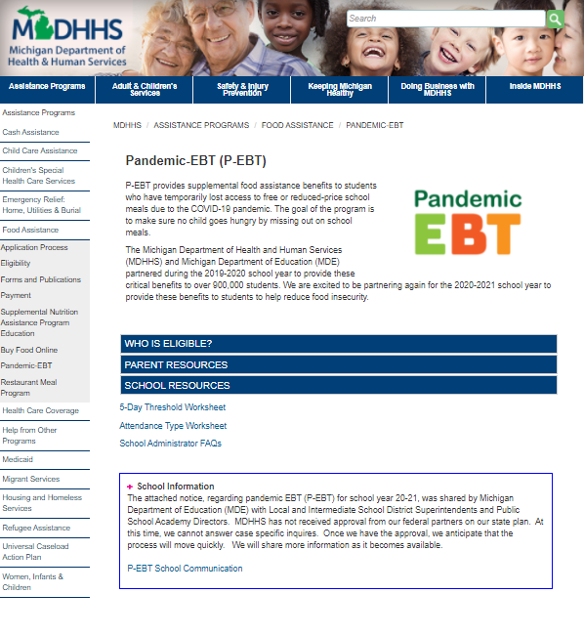
Additional Resources
More information can be found at michigan.gov/pebt
The website is frequently updated with new information
Listed there are both parent and school resources, with FAQ documents, worksheets, the reconsideration form, and past training materials
MI P-EBT 2.0 Reconsideration Training Guide 2020/2021 School Year

Slide 11
Still have questions?
School administrators or the designated contact can email us at:
MDHHS-PEBT@michigan.gov
This presentation and other reference materials are available at:
www.michigan.gov/pebt
MI P-EBT 2.0 Reconsideration Training Guide 2020/2021 School Year

